Slide 1

Predicting Heart Failure using Machine Learning(binary classification problems)
Frank Williams
Adrian Torres
Paige Madison

Slide 2
Data Origin
The survey data comes from the CDC’s Behavioral Risk Factor Surveillance System and was collected in 2023 and was collected from all 50 states.
The data does not have any Na values, but we did double check.

Slide 3
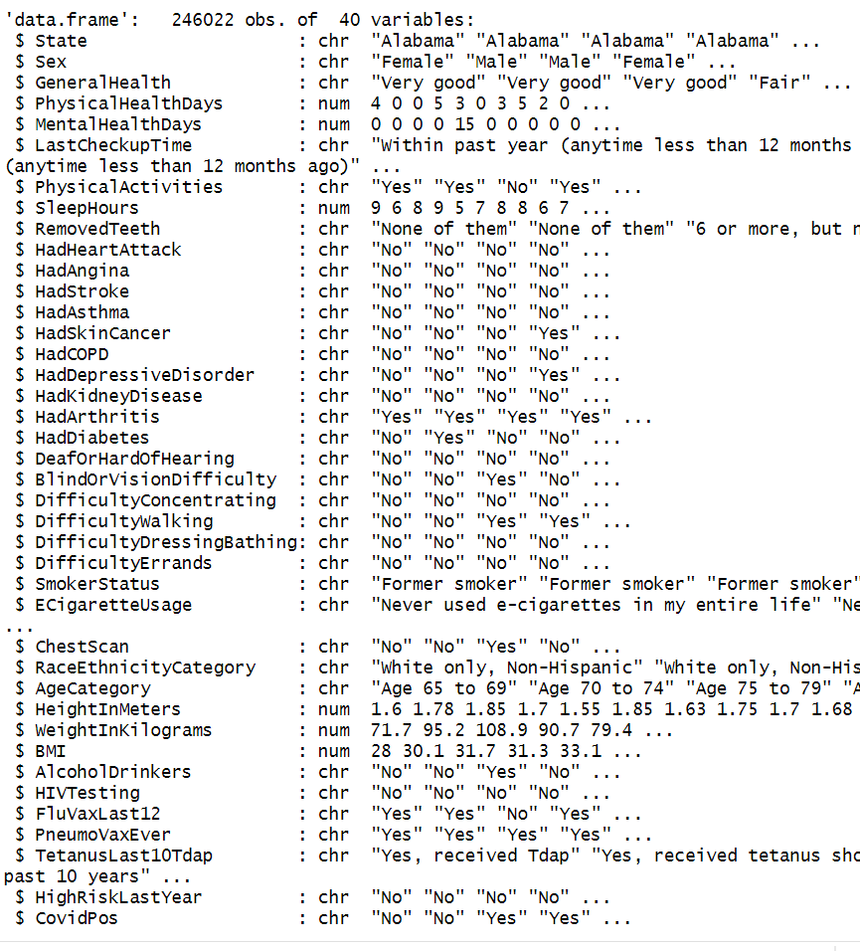
Data Structure
[1] 246022 37
Length of cat_cols: 31
Length of num_cols: 6
Length of dbl_cols: 6
Total number of columns in data_train: 38
Dataset did not have any Nas when being read in, due to being cleaned before using.

Slide 4
Steps to Complete
1. Define the Problem
2. Gather Data
3. Data Preprocessing
4. Exploratory Data Analysis (EDA)
5. Feature Selection/Extraction
6. Model Selection
7. Model Training
8. Model Evaluation
9. Iterate and Improve
10. Documentation and Communication

Slide 5
Main Questions
Can we accurately predict heart attacks?
Which variables are the most important for predicting heart attacks?
Are non-biological ailments like depression important for predicting heart attacks?

Slide 6
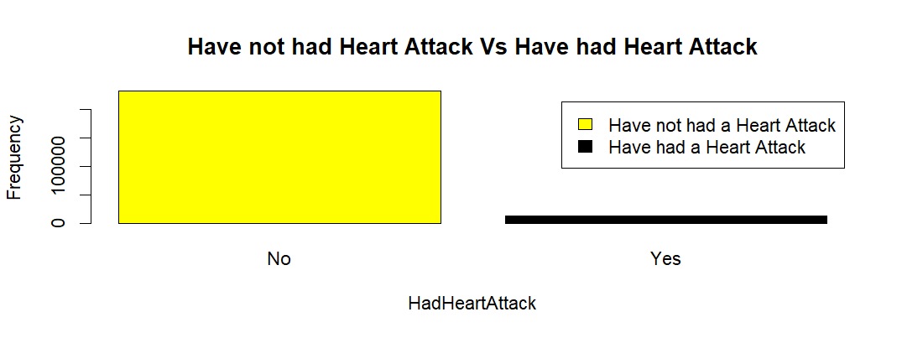
Exploratory Data Analysis: Visualizations

Slide 7
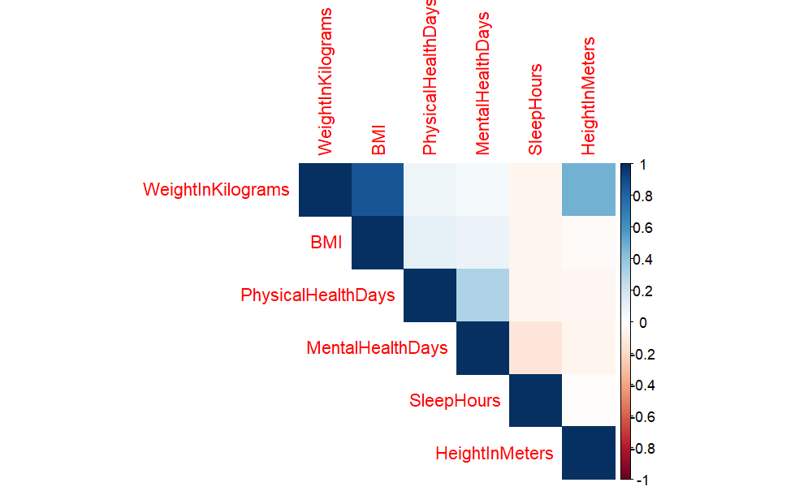
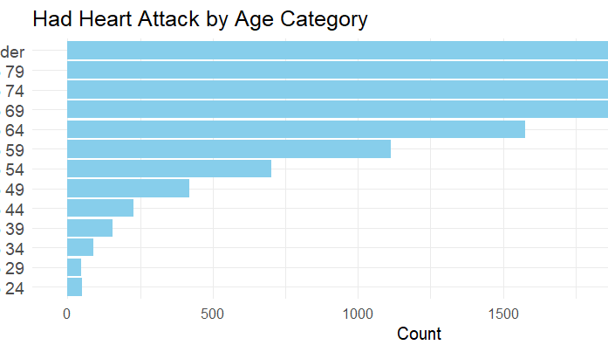
Exploratory Data Analysis: Visualizations

Slide 8
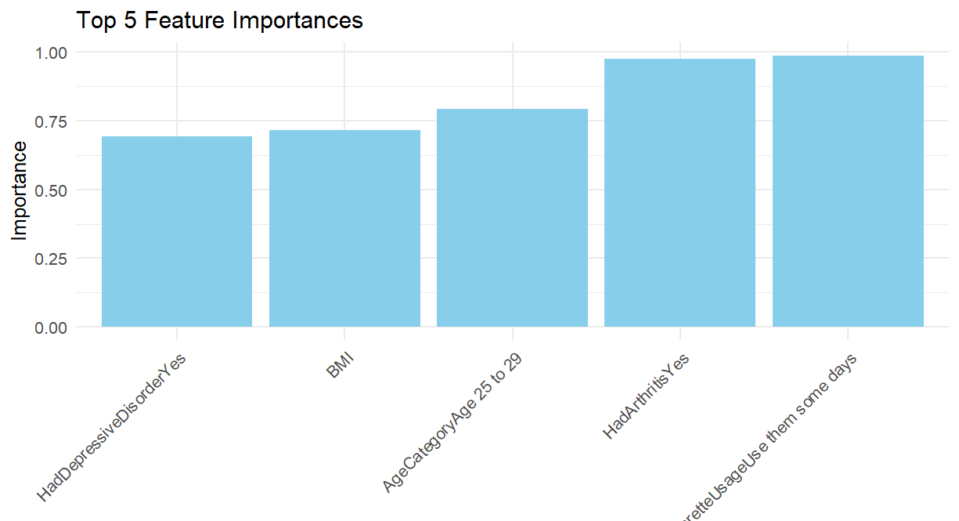
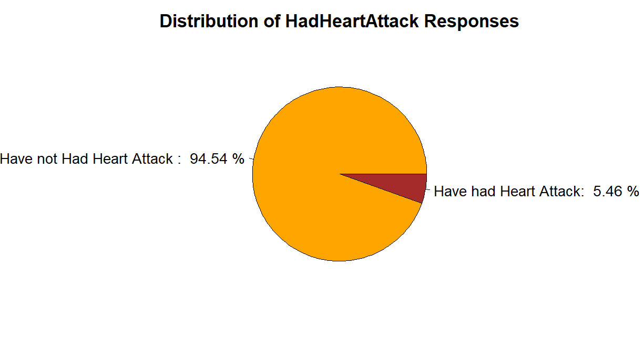
Logistic Regression Model Creation and Output
As can seen below, a patient who have had arthritis and used E-cigarettes experienced heart attacks more frequently.

Slide 9

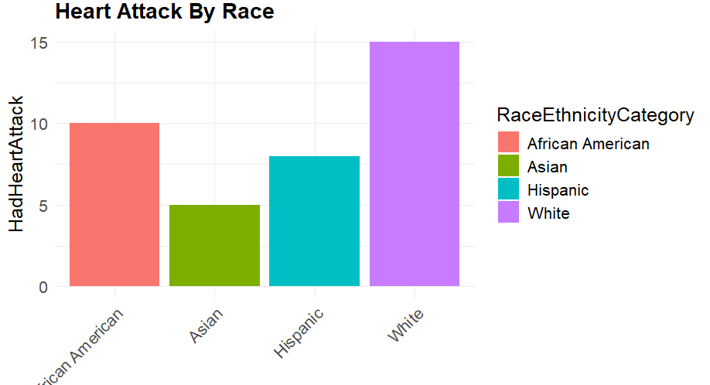
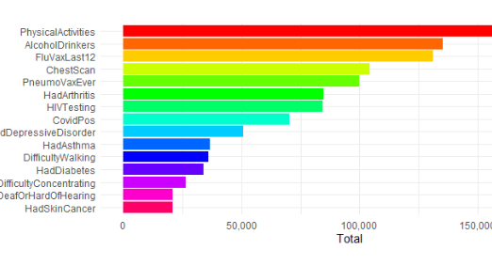
Logistic Model Creation and Output
Those who had the Pneumonia vaccine and had regular chest scans also experienced more heart attacks than other variables. You can also see that the White category has had the most heart attacks reported as well.

Slide 10
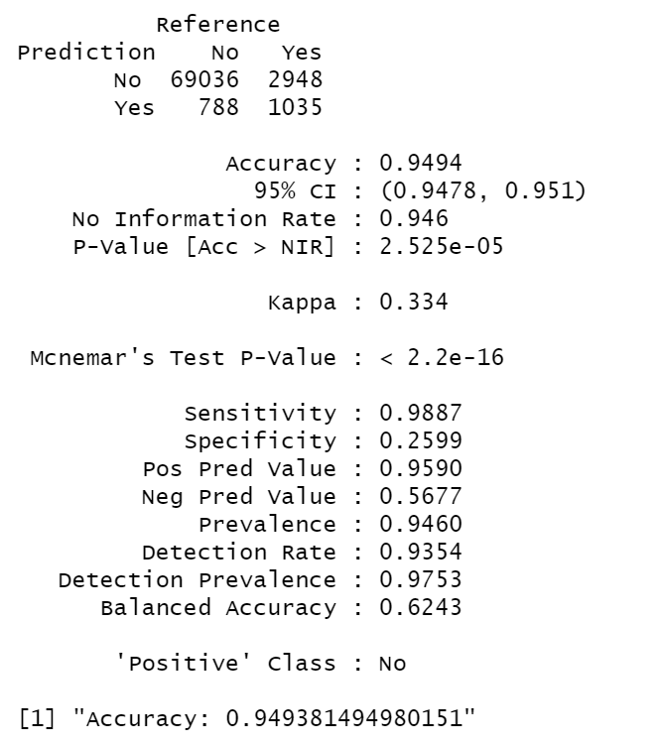
Logistic Model Creation and Output
# Model training# Fit logistic regression model
model <- glm(HadHeartAttack ~ ., data = train_data, family = binomial)
As can be seen in our output, we achieved an accuracy score of 94.94%.

Slide 11
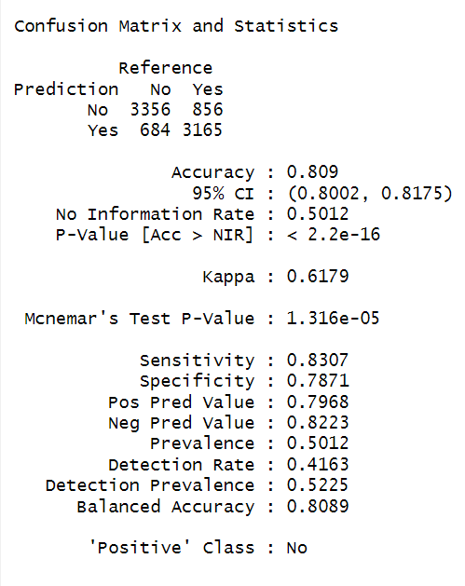
Logistic Model( undersampling majority class)Output
After, undersampling the “No” response the accuracy score dropped to 80.9%, which showed that the over prevalence of the “No” response influenced the accuracy.

Slide 12
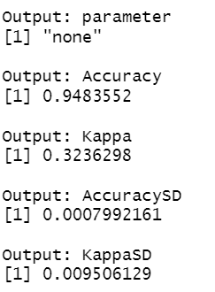
Model Outputs
As can be seen in the pictures of the model outputs, the accuracy metrics are very similar, but the K-fold version of the logistic regression model is slightly better.
K-Fold Logistic Regression Model
Logistic Regression Model

